Slide 1
Ch 2.4 – Functions as Mathematical Models

Slide 2
2.4 Functions as Mathematical Models (Shape of the graph)
Distance from Home
Distance from Home
Time Elapsed
Time Elapsed
bus
Distance from Home
wait
walk
Time Elapsed

Slide 3
44 a The table shows how the amount of water, A, flowing past a point on a river is related to the width, W, of the river at that point
Width (feet) | 11 | 23 | 34 | 46
Amount of water | 23 | 34 | 41 | 47
Y = k

Slide 4
Ch 2.6 – Domain and Range

Slide 5
Domain - The domain of a function is the set of permissible values for the input variable. The range is the set of function values ( that is , values of the output variable) that correspond to the domain values. Function- A relationship between two variables is a function if each element of the domain is paired with exactly one element of the range
Domain and Range
3
-3 0 3
Domain =[ -3 , 3 ]
Range = [ 0, 3]

Slide 6
STEP FUNCTION
5
4
3
2
1
Range
1 2 3 4 5 6 7
Domain
Domain: [ 3, 7]
Range: {1, 2, 3, 4}

Slide 7
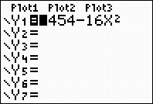
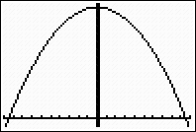
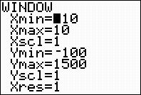
2.6 Domain and Range The function h= f(t) = 1454 – 16t² gives the height of an algebra book dropped from the top of the Sears Tower as a function of time. Give a suitable domain for this application, and the corresponding range
Enter y Enter window Press graph
[ -10, 10, 1] by [ - 100, 1500, 1]
Range
-10 0 10
Domain

Slide 8
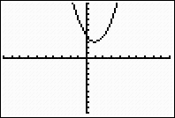
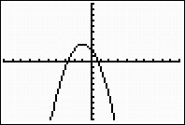
Ex- 2.6 , 28a) Find the Domain of each function a) h(n ) = 3 + (n – 1)² b) g(n) = 3 - (n + 1)²
3
3
1
-1
h(n ) = 3 + (n – 1)²
Domain : all reals
Range :[3 , ∞ )
g(n) = 3 - (n + 1)²
Domain : all reals
Range :( - ∞ , 3 ]

Slide 9
57 The domain of f is [0, 10] and the range is [-2, 2] a) y = f(x - 3) b) 3 f(x) c) 2f(x- 5) Solution
a) Translate the domain right 3 units Domain [ 3, 13]; Range : [-2, 2] b) Stretch the range vertically by a factor of 3. Domain [0, 10] by [-6, 6] c) Stretch the range vertically by a factor of 2, and translate the domain right 5 units. Domain: [5, 15] and Range : [-4, 4]

